Slide 1
BrewNow Delivering Premium BeeR To Your Door
Cadet Lee and Cadet Ruyak

Slide 2
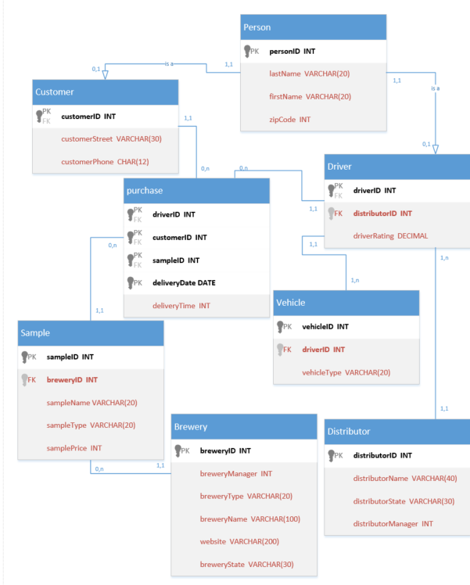
Relational Schema

Slide 3
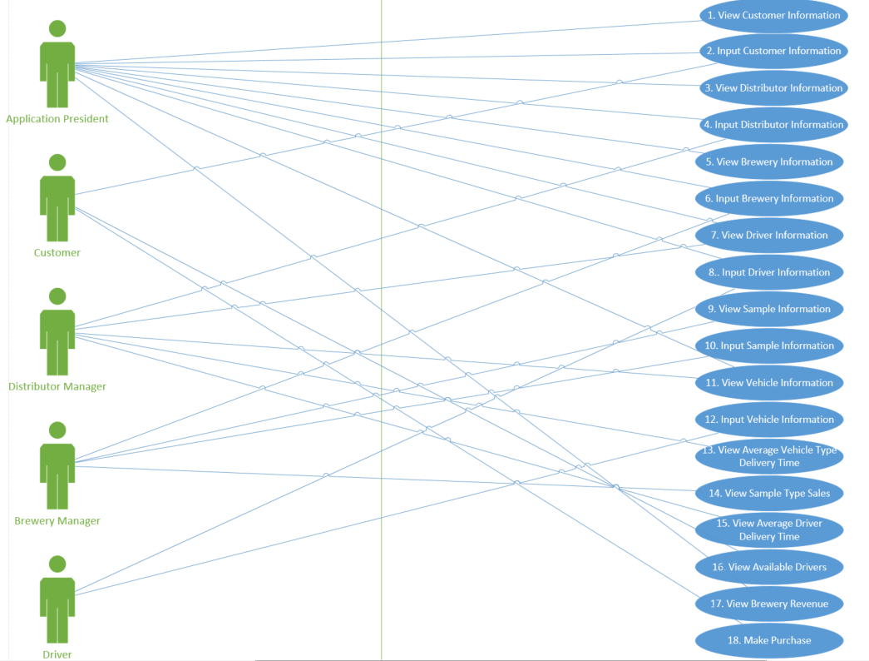
Use Cases

Slide 4
Use Case Paragraphs (Inputs and Basic Viewing)
1. View Customer Information: Display a list of all customers in the application, listing their ID, last name, first name, zip code, address, and phone number.
2. Input Customer Information: Enter customer ID, last name, first name, zip code, address, and phone number, creating a new entry in Customer.
3. View Distributor Information: Display a list of all distributors in the application, listing their ID, name, state, and manager ID.
4. Input Distributor Information: Enter distributor ID, name, state, and manager ID, creating a new entry in Distributor.
5. View Brewery Information: Display a list of all breweries in the application, listing their ID, name, state, type, website, and manager ID.
6. Input Brewery Information: Enter brewery ID, name, state, type, website, and manager ID, creating a new entry in Brewery.
7. View Driver Information: Display a list of all drivers in the application, listing their ID, last name, first name, zip code, distributor ID, and rating.
8. Input Driver Information: Enter driver ID, last name, first name, zip code, distributor ID, and rating, creating a new entry in Driver.
9. View Sample Information: Display a list of all samples in the application, listing their ID, brewery ID, type, and price.
10. Input Sample Information: Enter sample ID, brewery ID, type, and price, creating a new entry in Sample.
11. View Vehicle Information: Display a list of all vehicles in the application, listing their ID, driver ID, and type.
12. Input Vehicle Information: Enter vehicle ID, driver ID, and type, creating a new entry in Vehicle.

Slide 5
Use Case Paragraphs (Non-Trivial)
13. View Average Vehicle Type Delivery Time: Given a vehicle type, view its average delivery time.
14. View Sample Type Sales: Given a sample type, view a running total of deliveries (sales) made for that type.
15. View Average Driver Delivery Time: Given a driver ID, view the average delivery time per sale of that particular driver.
16. View Available Drivers: Given a customer ID, view all drivers in the same zip code (available for delivery) to that customer.
17. View Brewery Revenue: Given a brewery ID, view its total revenue derived from the sum of all sales made through its samples.
18. Make Purchase: Given a customer ID, driver ID, sample ID, and delivery date, make a purchase, adding a new entry to the purchase table.

Slide 6
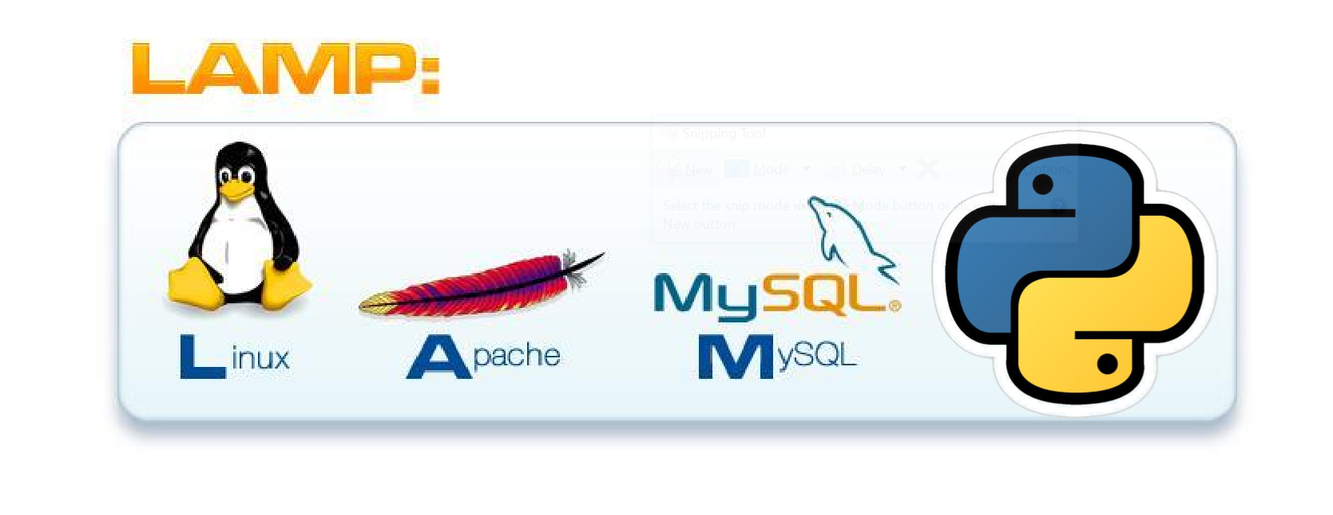
Technology
Python: Kaggle Data Set ‘Breweries’ parsed with Python
Linux/Apache: EECS Machine Usage to Integrate Stack
MySQL: DBMS Back-End with BrewNow Database
Python: Generates Web Server Front-End with BrewNow Interface

Slide 7
Web Server Demo

Slide 8
Works cited
“Examples¶.” Examples - PyMySQL 0.7.2 Documentation, pymysql.readthedocs.io/en/latest/user/examples.html.
Jay. “Creating a Web App From Scratch Using Python Flask and MySQL: Part 4.” Code Envato Tuts+, 23 June 2015, code.tutsplus.com/tutorials/creating-a-web-app-from-scratch-using-python-flask-and-mysql-part-4--cms-23187.
“MySQL Connector/Python Developer Guide :: 10.5.2 MySQLCursor.callproc() Method.” MySQL, dev.mysql.com/doc/connector-python/en/connector-python-api-mysqlcursor-callproc.html.

